Slide 1


Web Archival Survey of Global Data Portals
David Calano
CS 895: Web Archiving Forensics
Old Dominion University
November 28th, 2022
lifefromalaptop
CS895: Web Archiving Forensics
Fall 2022

Slide 2
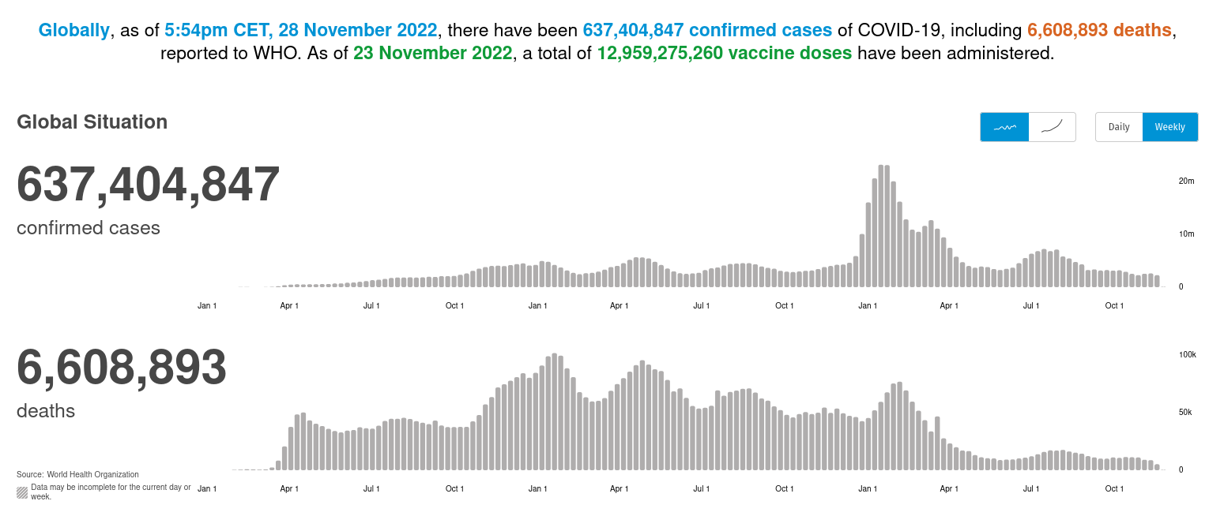
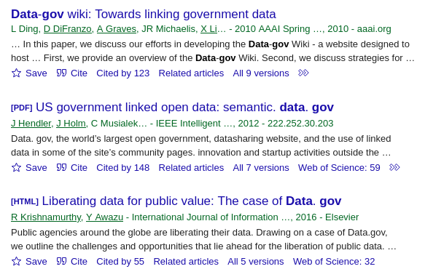
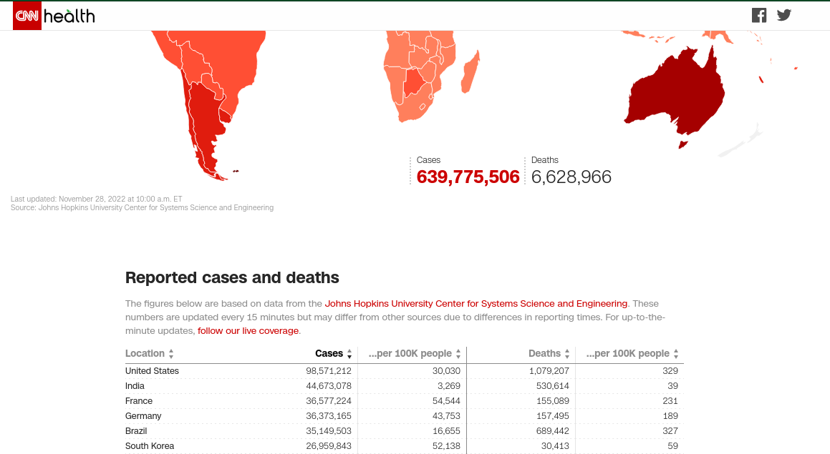

Who Cares About Statistical Data?
https://www.cnn.com/interactive/2020/health/coronavirus-maps-and-cases/
https://covid19.who.int/
lifefromalaptop
CS895: Web Archiving Forensics
Fall 2022

Slide 3
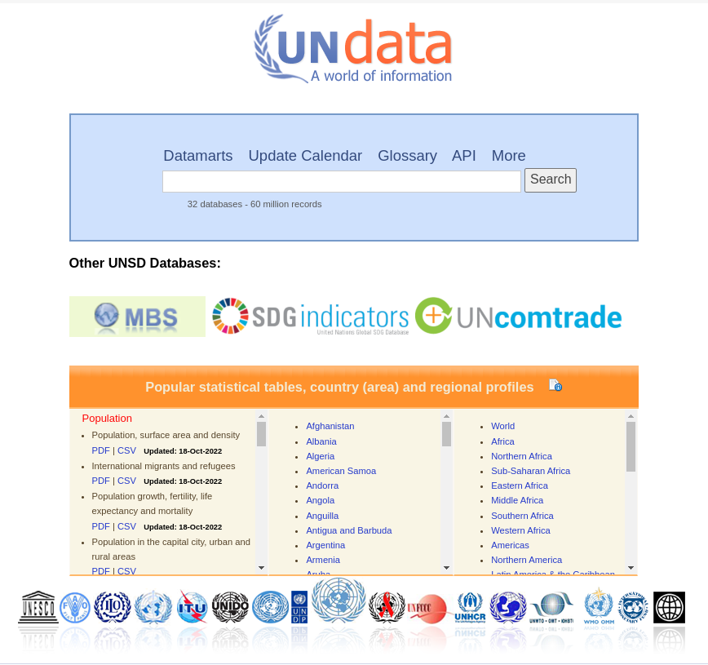
First Impressions?
https://data.un.org/
lifefromalaptop
CS895: Web Archiving Forensics
Fall 2022

Slide 4
Vast and Infinite
https://data.un.org/
lifefromalaptop
CS895: Web Archiving Forensics
Fall 2022

Slide 5
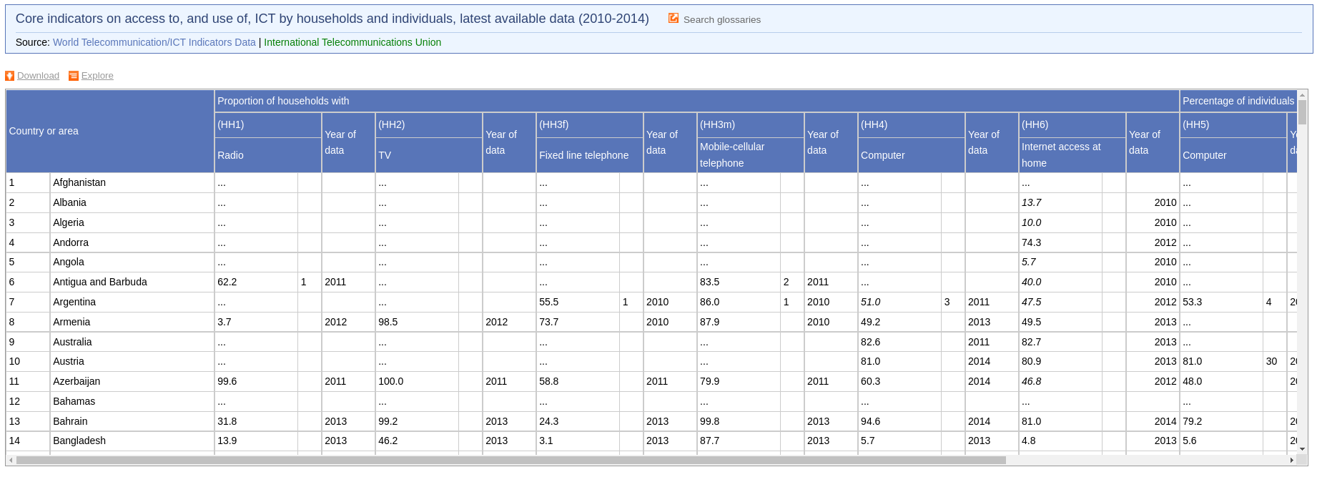
Inherent Sparsity
http://data.un.org/DocumentData.aspx?id=374
lifefromalaptop
CS895: Web Archiving Forensics
Fall 2022
Notes:
More often than not, data is

Slide 6
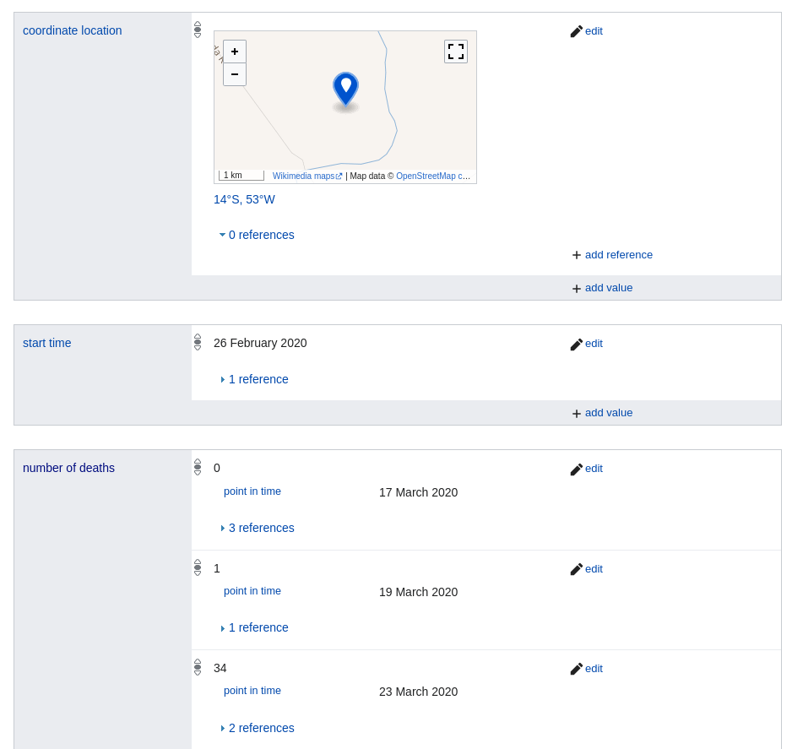
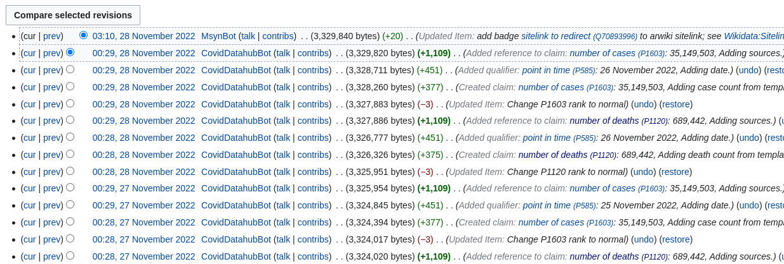
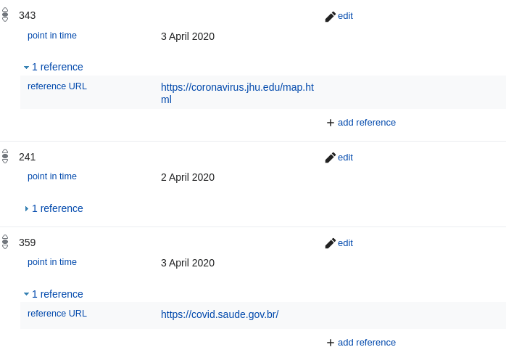
Paradoxes of Collaboration
https://www.wikidata.org/wiki/Q86597695
lifefromalaptop
CS895: Web Archiving Forensics
Fall 2022
Notes:
More often than not, data is

Slide 7
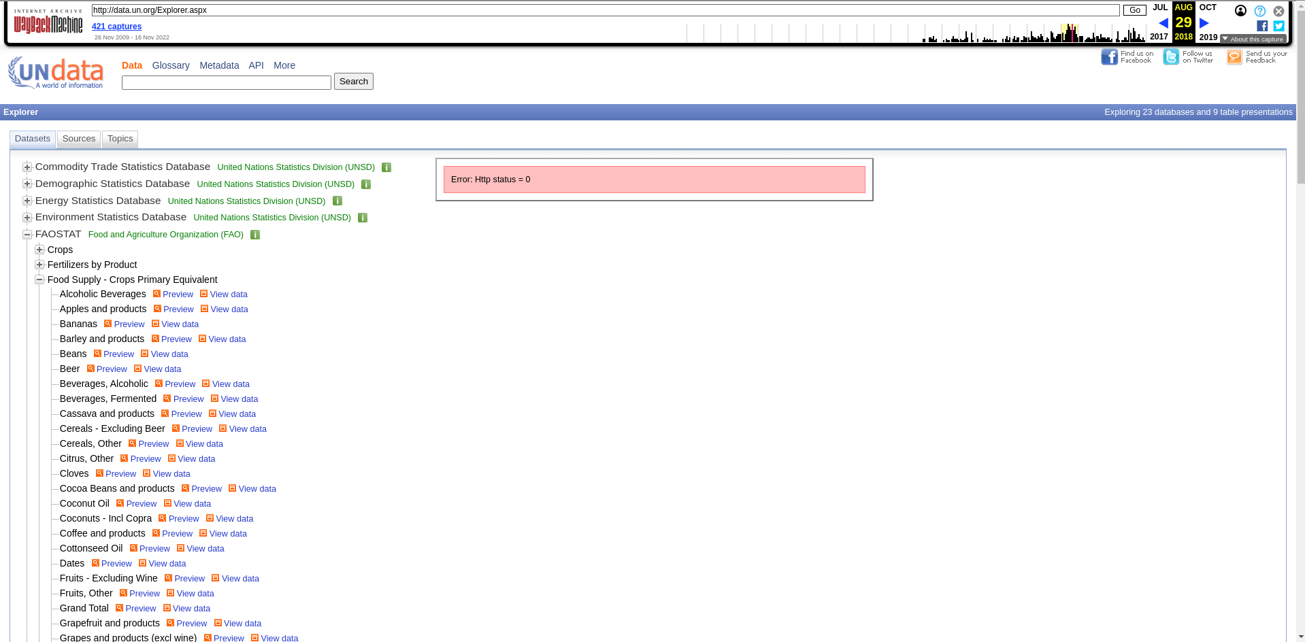
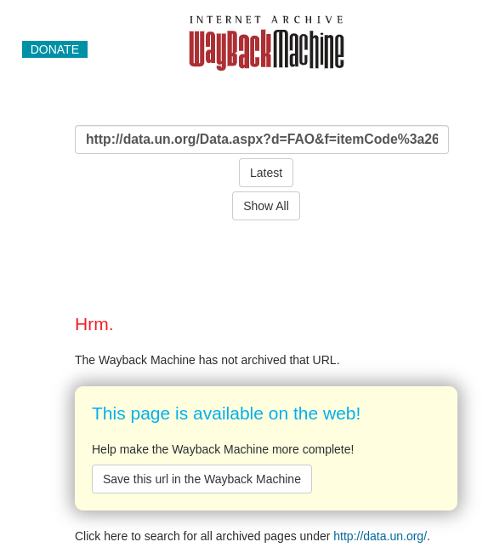
Data Archive =/= Archived Data
https://web.archive.org/web/20180829235347/http://data.un.org/Explorer.aspx
lifefromalaptop
CS895: Web Archiving Forensics
Fall 2022

Slide 8
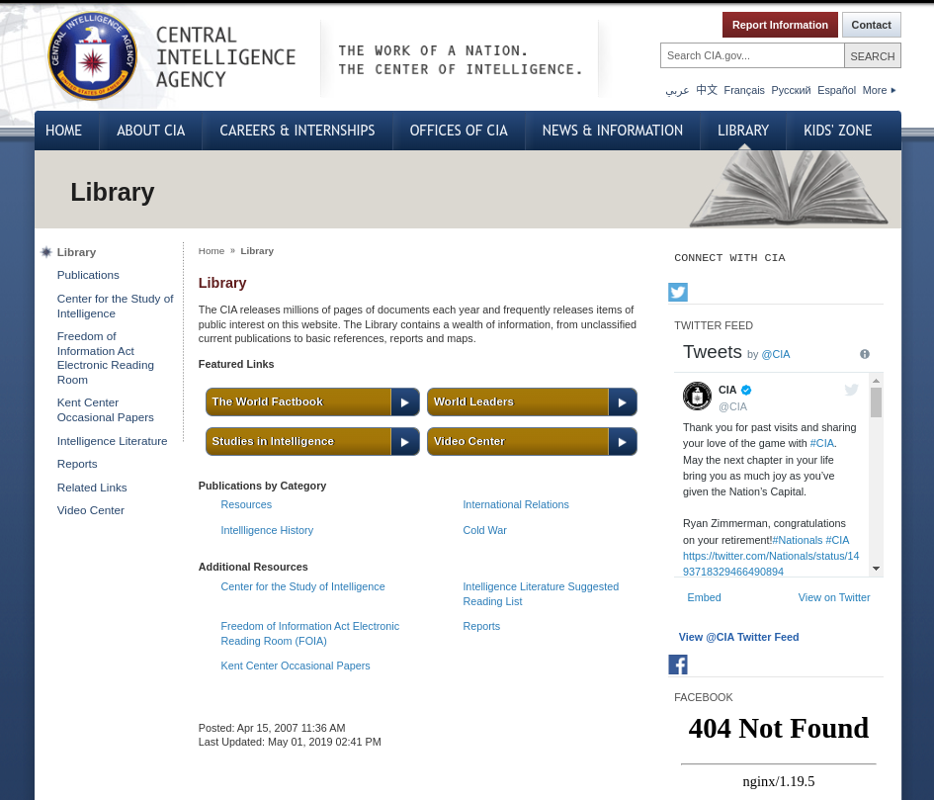
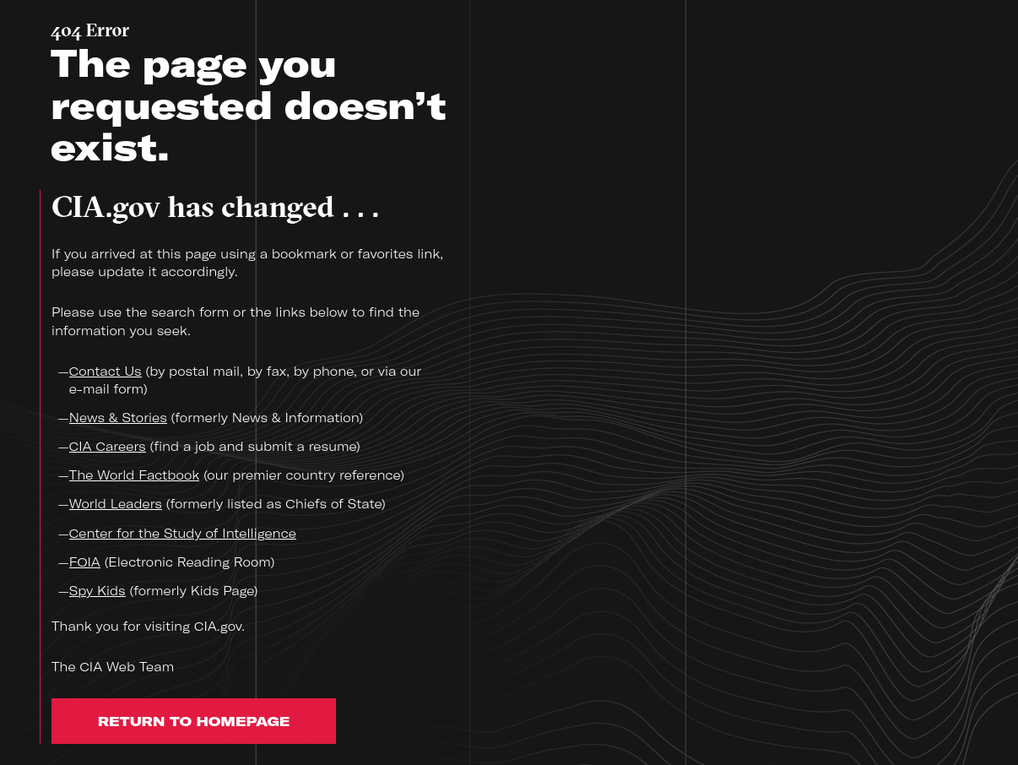
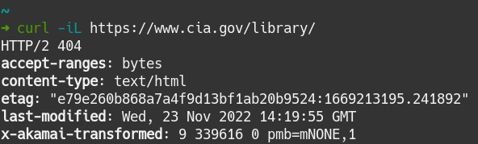
A State of Suspended Animation
https://web.archive.org/web/20190715001358/https://www.cia.gov/library/
https://cia.gov/library/
lifefromalaptop
CS895: Web Archiving Forensics
Fall 2022

Slide 9
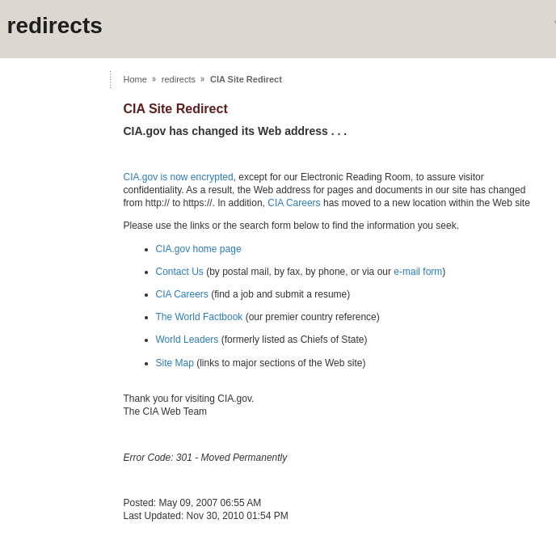
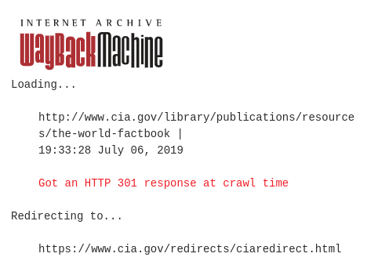
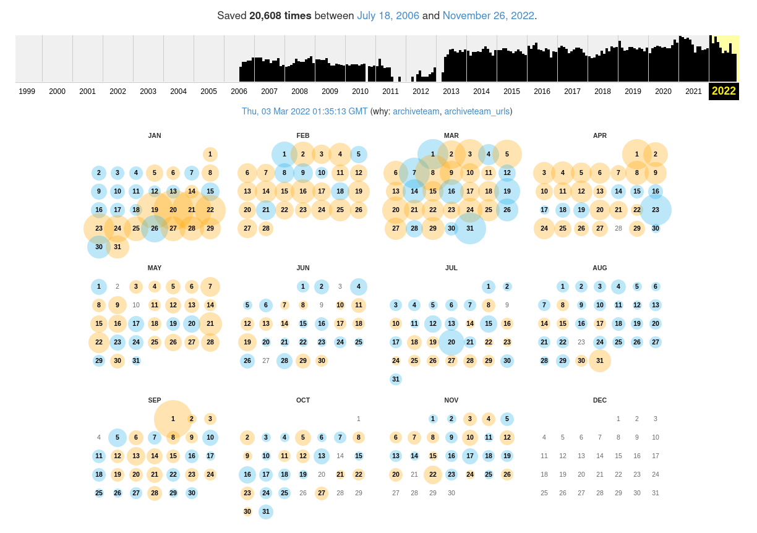
Persistent Consequences
https://web.archive.org/web/20190706174759/https://www.cia.gov/redirects/ciaredirect.html
lifefromalaptop
CS895: Web Archiving Forensics
Fall 2022
Notes:
More often than not, data is

Slide 10
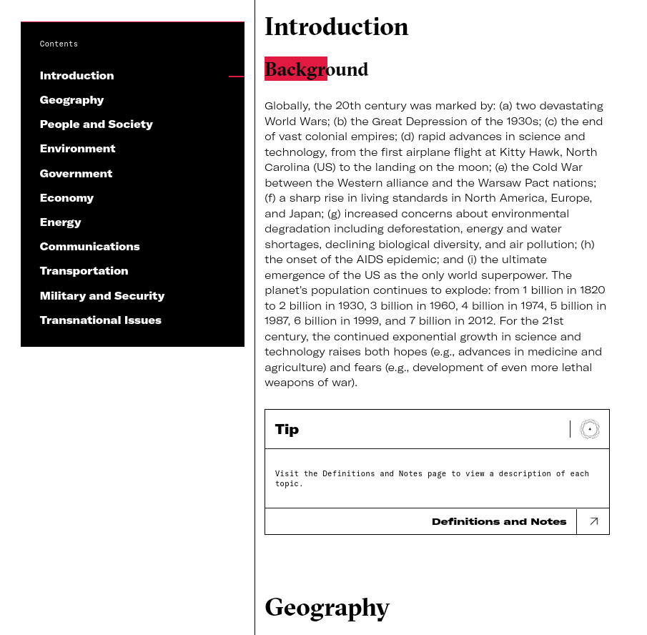
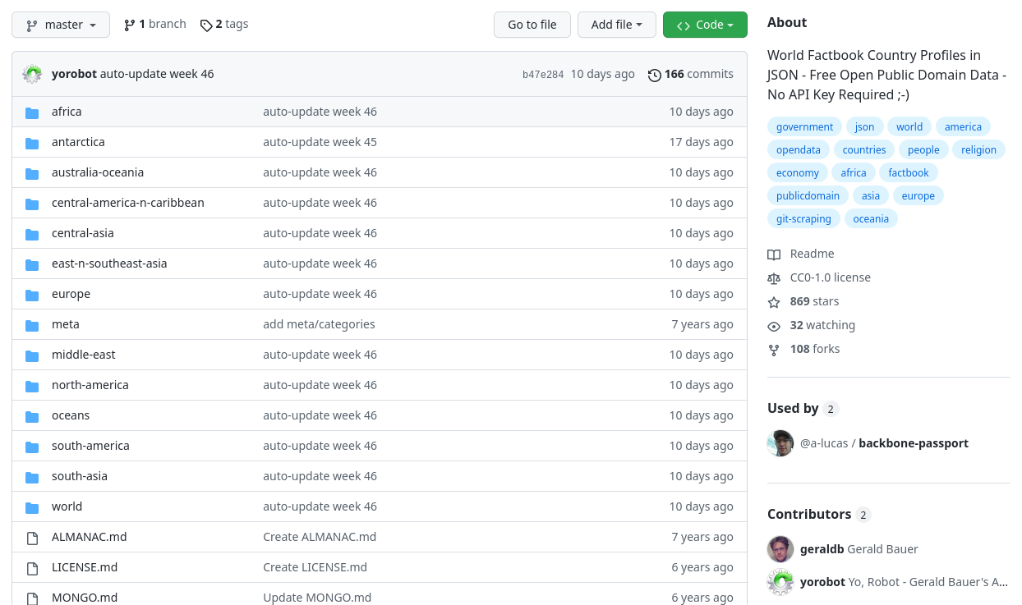
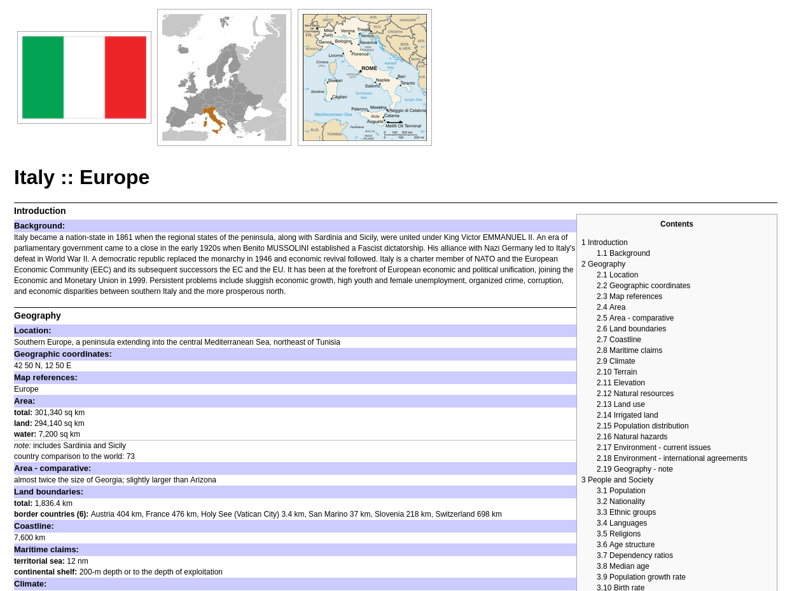
3rd-Party Adaptations
https://factbook.github.io/it
https://www.cia.gov/the-world-factbook/countries/world/
https://github.com/factbook/factbook
https://factbook.github.io/it
lifefromalaptop
CS895: Web Archiving Forensics
Fall 2022
Notes:
More often than not, data is

Slide 11
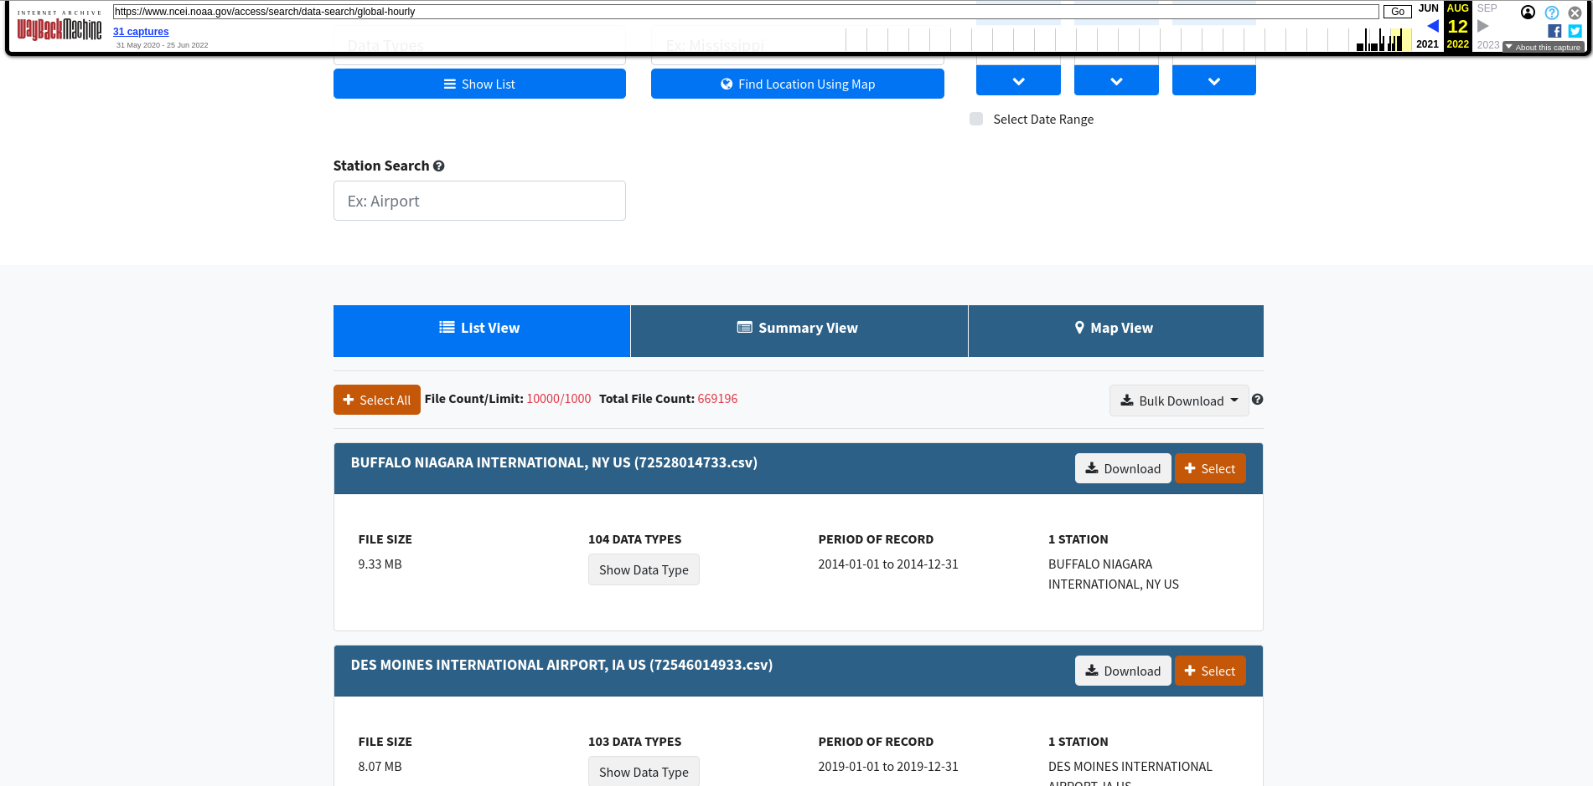

Missing Archival Data
https://web.archive.org/web/20220812130920/https://www.ncei.noaa.gov/access/search/data-search/global-hourly
lifefromalaptop
CS895: Web Archiving Forensics
Fall 2022
Notes:
More often than not, data is

Slide 12
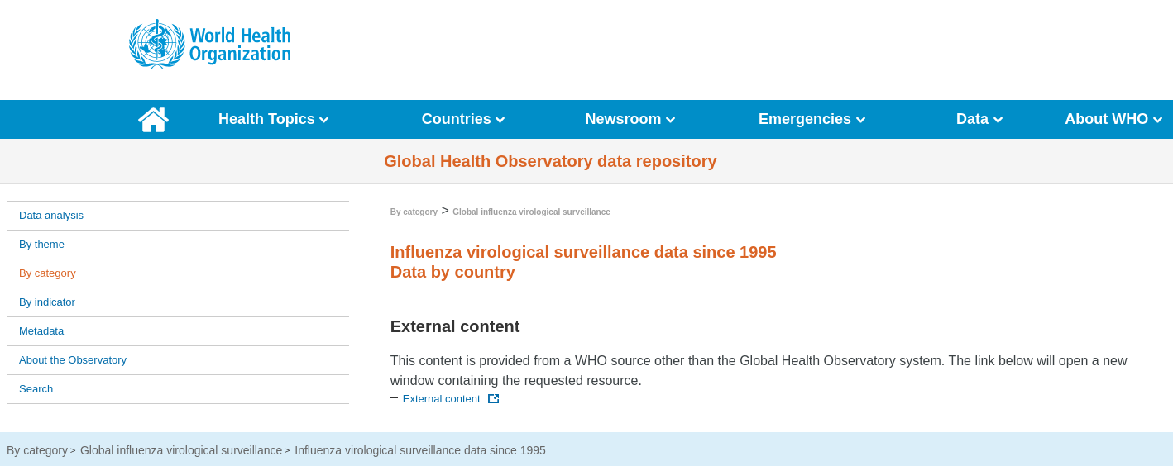
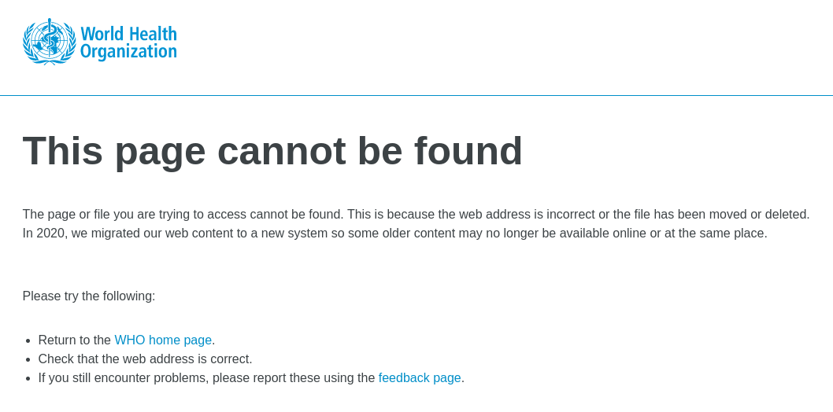
Missing Live Data
https://apps.who.int/gho/data/node.main.173?lang=en
https://www.who.int/globalatlas/loginManagement/autoLogins/flunet_login.asp
lifefromalaptop
CS895: Web Archiving Forensics
Fall 2022
Notes:
More often than not, data is

Slide 13
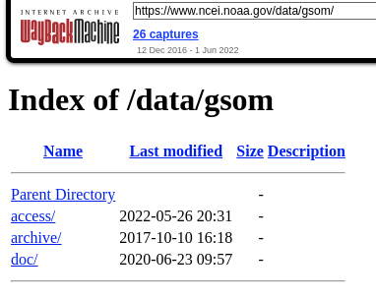
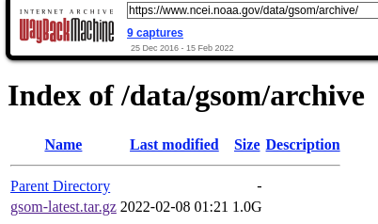

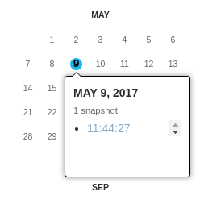
Temporal Archive Issues
https://web.archive.org/web/20220215030230/https://www.ncei.noaa.gov/data/gsom/archive/
https://web.archive.org/web/20220601162542/https://www.ncei.noaa.gov/data/gsom/
https://web.archive.org/web/20170509114427/https://www.ncei.noaa.gov/data/gsom/archive/gsom-latest.tar.gz
lifefromalaptop
CS895: Web Archiving Forensics
Fall 2022
Notes:
More often than not, data is

Slide 14
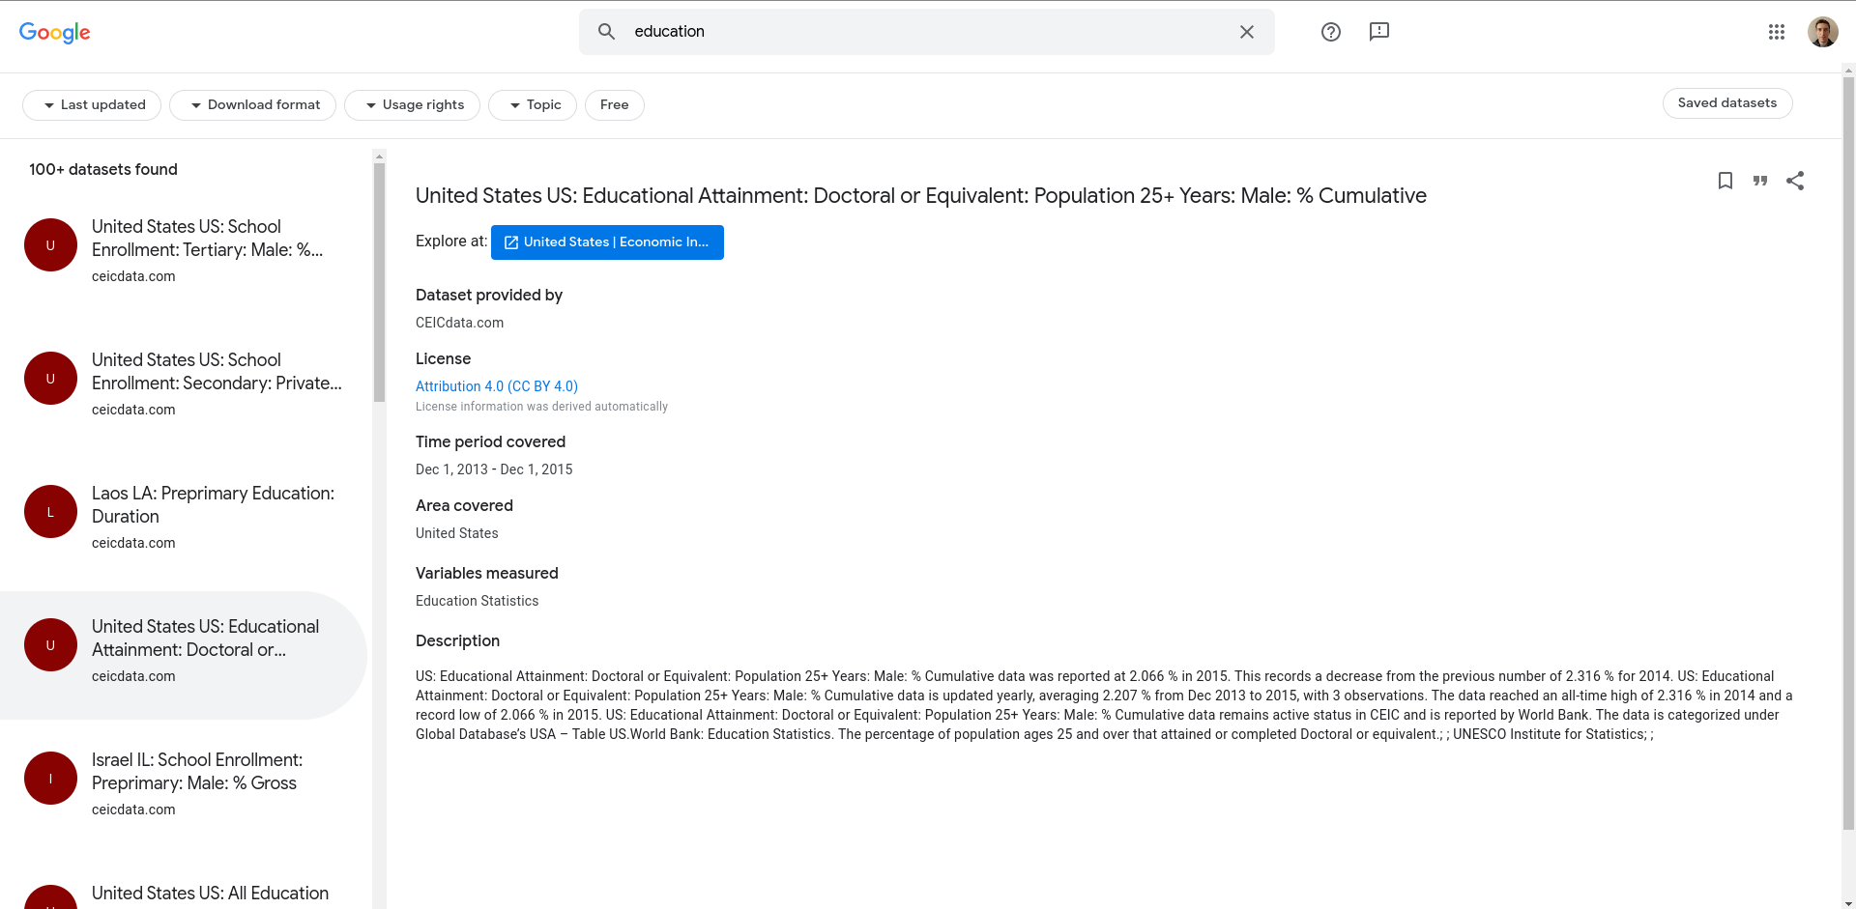
Impractical Archives
https://datasetsearch.research.google.com/search?src=0&query=education&docid=L2cvMTFyaHp0NXl3Xw%3D%3D
lifefromalaptop
CS895: Web Archiving Forensics
Fall 2022
Notes:
More often than not, data is

Slide 15
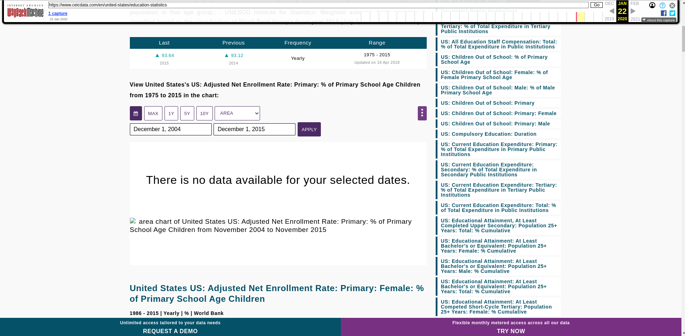
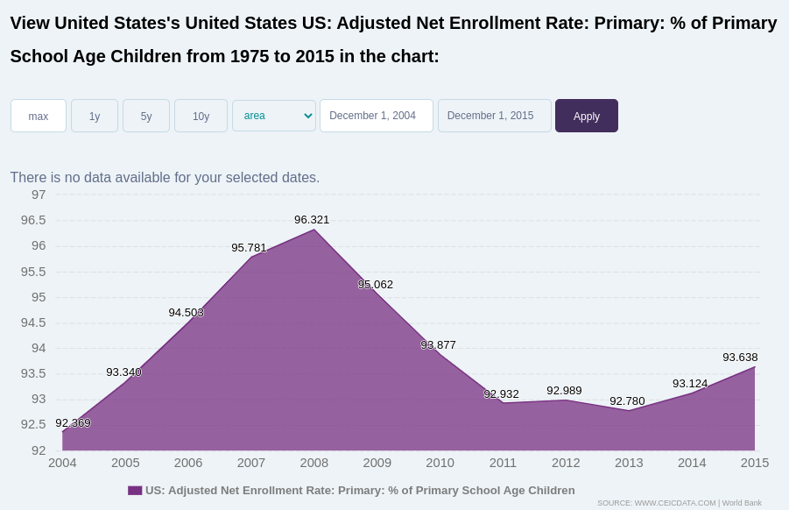
Our Old Friend, JavaScript
https://web.archive.org/web/20200122125450/https://www.ceicdata.com/en/united-states/education-statistics
lifefromalaptop
CS895: Web Archiving Forensics
Fall 2022
Notes:
More often than not, data is

Slide 16
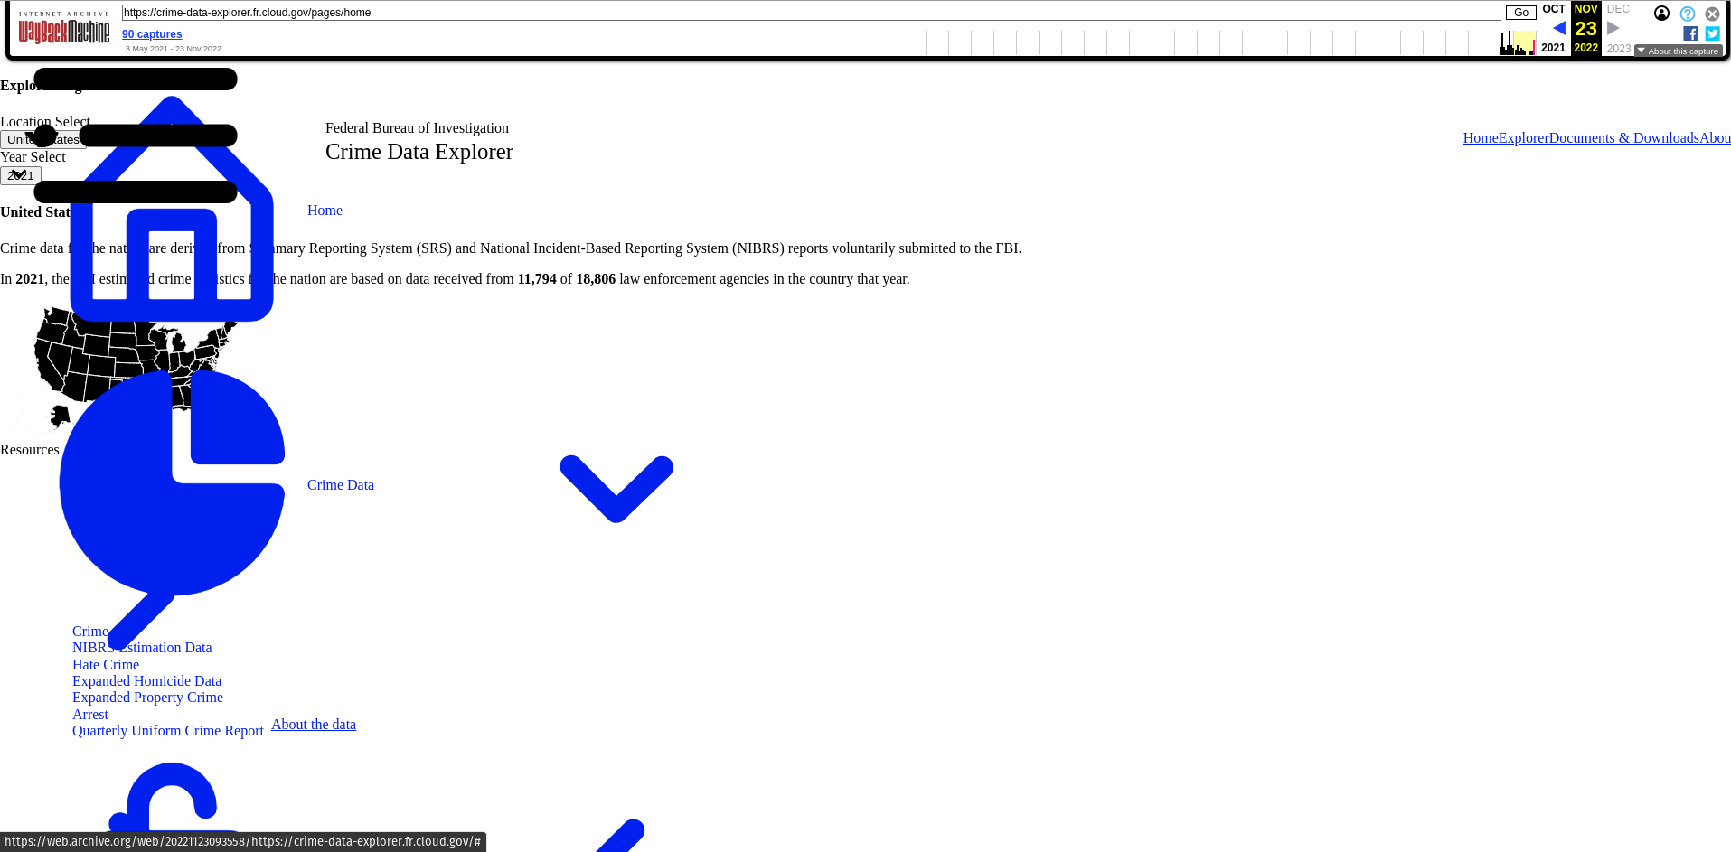
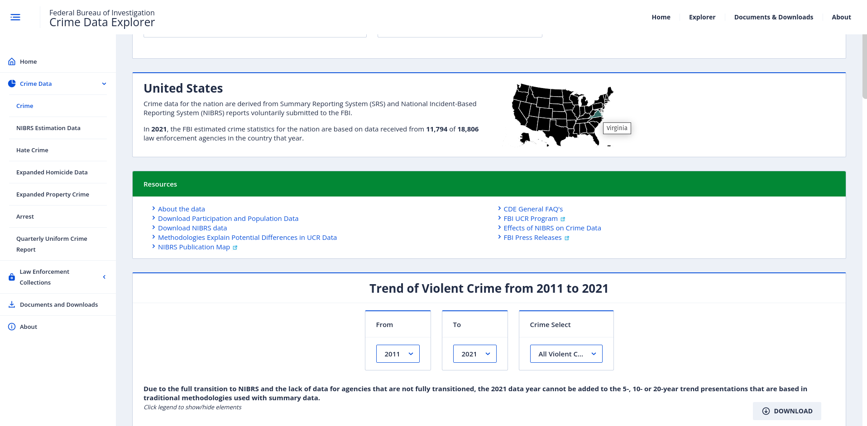
Federal Bureau of Inaccessibility
https://crime-data-explorer.fr.cloud.gov/pages/explorer/crime/crime-trend
https://web.archive.org/web/20221123093558/https://crime-data-explorer.fr.cloud.gov/pages/explorer/crime/crime-trend
lifefromalaptop
CS895: Web Archiving Forensics
Fall 2022
Notes:
More often than not, data is

Slide 17
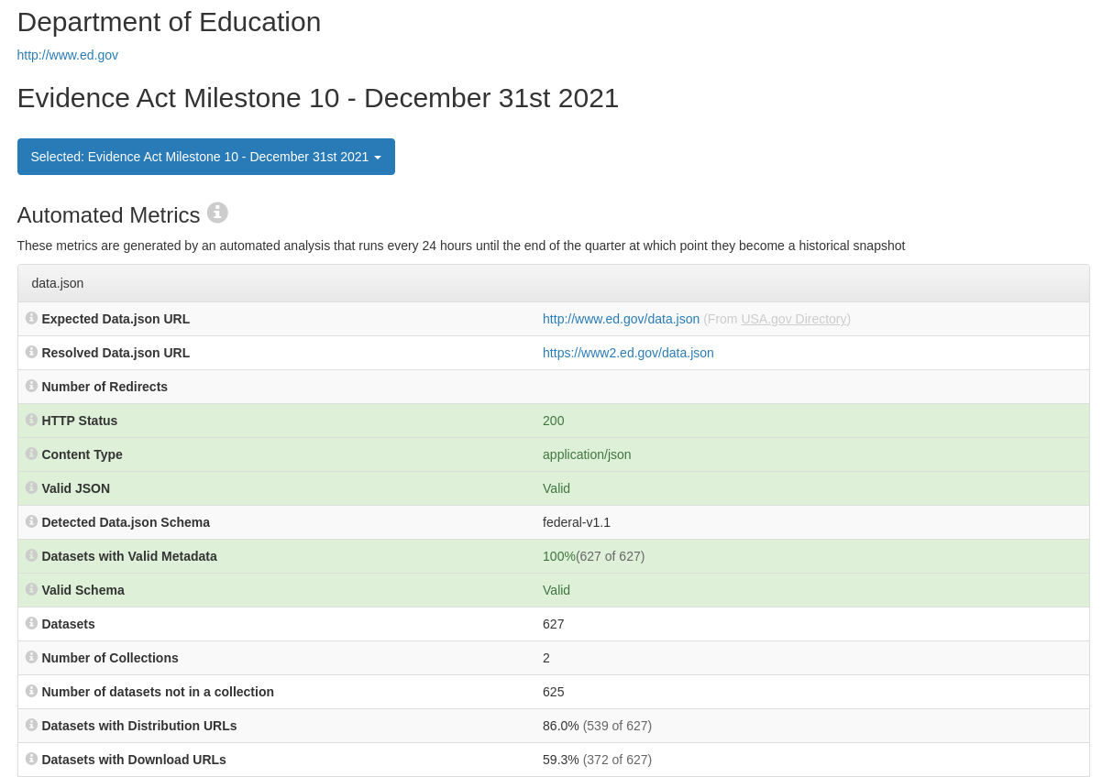
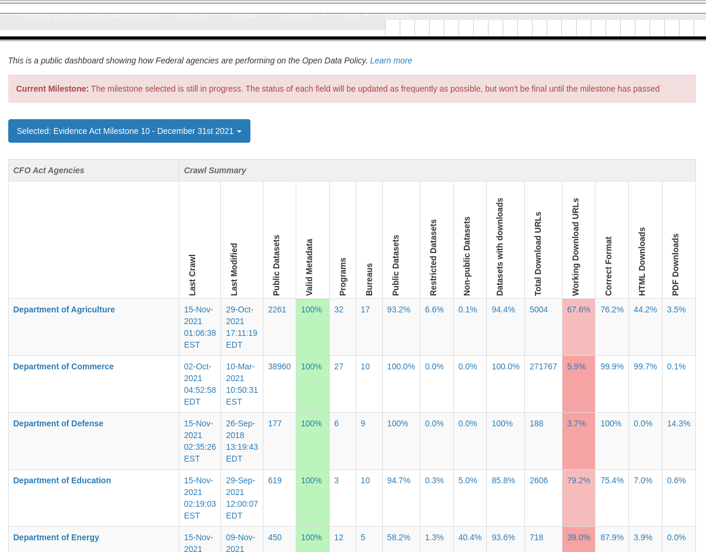
Finding Workable Balances
https://web.archive.org/web/20220610035834/https://data.gov/metrics.html
https://web.archive.org/web/20220804223950/https://dashboard.data.gov/offices/detail/49018/2021-12-31
lifefromalaptop
CS895: Web Archiving Forensics
Fall 2022
Notes:
More often than not, data is

Slide 18
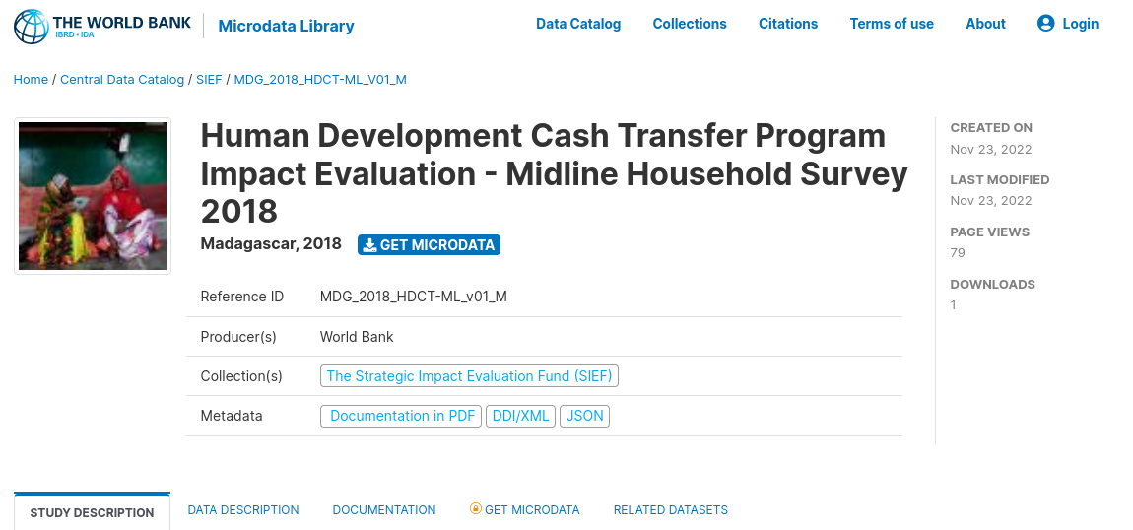
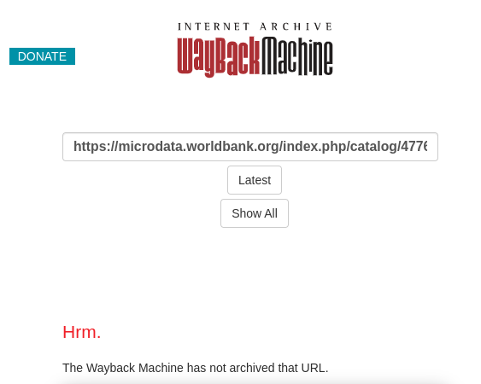
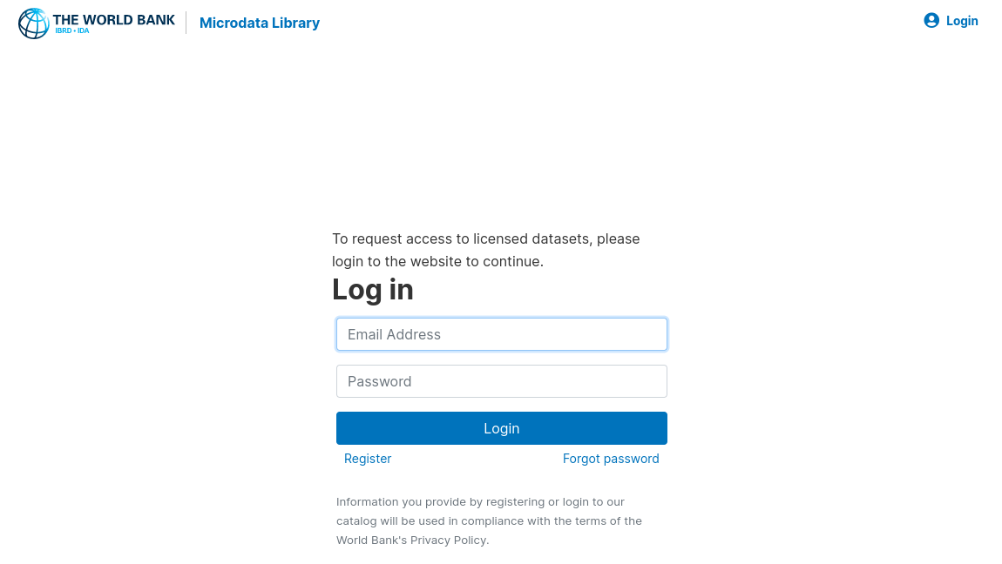
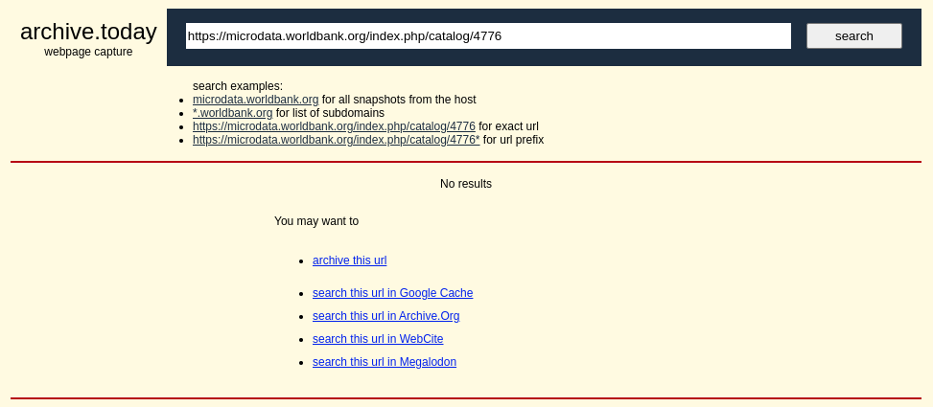
Limitations of Walled Gardens
https://microdata.worldbank.org/index.php/catalog/4776
lifefromalaptop
CS895: Web Archiving Forensics
Fall 2022
Notes:
More often than not, data is

Slide 19
Conclusions
Disparate and dynamic data requires integrative tooling
Need for robust systems to limit the downsides of siloed data
Automation of data gathering and preservation
Finding balance between accessibility and usability
Temporal importance of live and archived data
Beware of long-lasting design consequences
lifefromalaptop
CS895: Web Archiving Forensics
Fall 2022
Notes:
More often than not, data is

